Slide 2
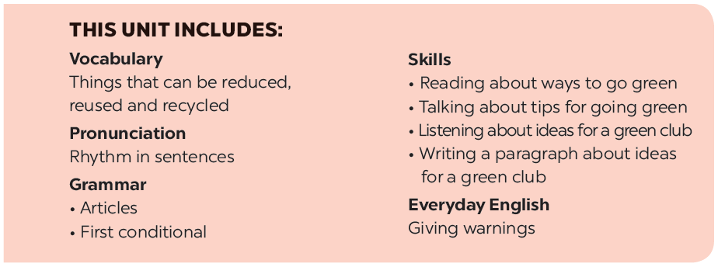

Slide 3
Listening
Writing
Listen to two students talking about what they will do if they become the president of the 3Rs Club. Fill each blank with a word or a number.
Interview a classmate. Ask him/ her what two things he / she will do if he / she becomes the president of the 3Rs Club. Take notes below.
Listen again and tick () T (True) or F (False).
Write a paragraph about your classmate’s ideas in 3. Write about 50 words.

Slide 4
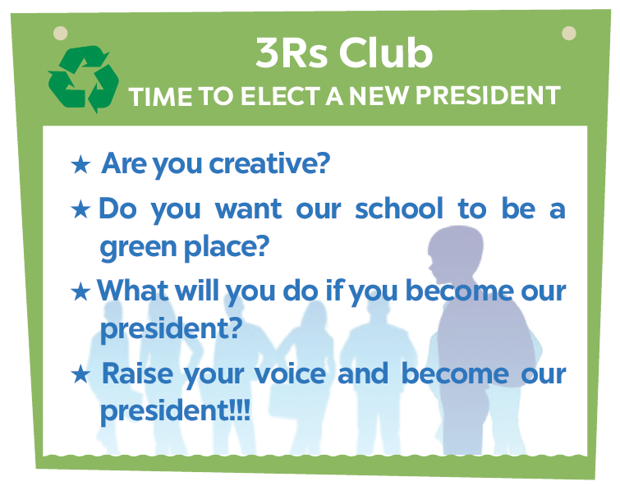
Listening

Slide 5
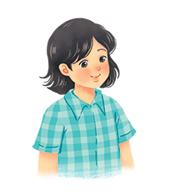
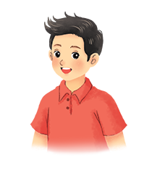
Listen to two students talking about what they will do if they become the president of the 3Rs Club. Fill each blank with a word or a number.
Mi
Nam

Slide 6
Name | Mi
Class | (1)
Ideal 1 | Putting a (2) bin in every classroom
Ideal 2 | Having (3) fairs
6A
recycling
book
Audio script

Slide 7
AUDIO SCRIPT
Mi: I'm Mi from class 6A. If I become the president of the Club, I'll first talk to my friends about putting a recycling bin in every classroom. We can reuse the things we have in these bins. Secondly, I'll organise some book fairs. Students can exchange their used books at these fairs.

Slide 8
Name | Nam
Class | (4)
Ideal 1 | Encouraging students to use (5)
Ideal 2 | Organising (6) fairs
6E
bus
uniform
Audio script

Slide 9
AUDIO SCRIPT
Nam: I'm Nam from class 6E. If I become the president of the Club, I'll encourage students to go to school by bus. It'll be fun and help the environment. Next, I'll organise some uniform fairs. This is where students can exchange used uniforms with other students.

Slide 10
Listen again and tick () T (True) or F (False).
 | T | F
1. Mi thinks they can recycle things in the bins.
2. At book fairs, students can exchange their old books.
3. Nam thinks students will save money if they go to school by bus.
4. Students can exchange their used uniforms at uniform fairs.




Audio script

Slide 11
AUDIO SCRIPT
Mi: I'm Mi from class 6A. If I become the president of the Club, I'll first talk to my friends about putting a recycling bin in every classroom. We can reuse the things we have in these bins. Secondly, I'll organise some book fairs. Students can exchange their used books at these fairs.
Nam: I'm Nam from class 6E. If I become the president of the Club, I'll encourage students to go to school by bus. It'll be fun and help the environment. Next, I'll organise some uniform fairs. This is where students can exchange used uniforms with other students.

Slide 12
Writing

Slide 13
Interview a classmate. Ask him/ her what two things he / she will do if he / she becomes the president of the 3Rs Club. Take notes below.
Name ___________________________
Idea 1 ___________________________
Idea 2 ___________________________
Study Skill - Writing
Giving explanations and / or examples is an important writing skill.
You should give explanations and / or examples to support your ideas.
Example:
Secondly, I’ll organise some book fairs. At these events students can exchange their used books.

Slide 14
Write a paragraph about your classmate’s ideas in 3. Write about 50 words.
My classmate is _________________. If _______ becomes the president of the 3Rs Club, ______ will do two things. Firstly, ________________________

